Slide 1





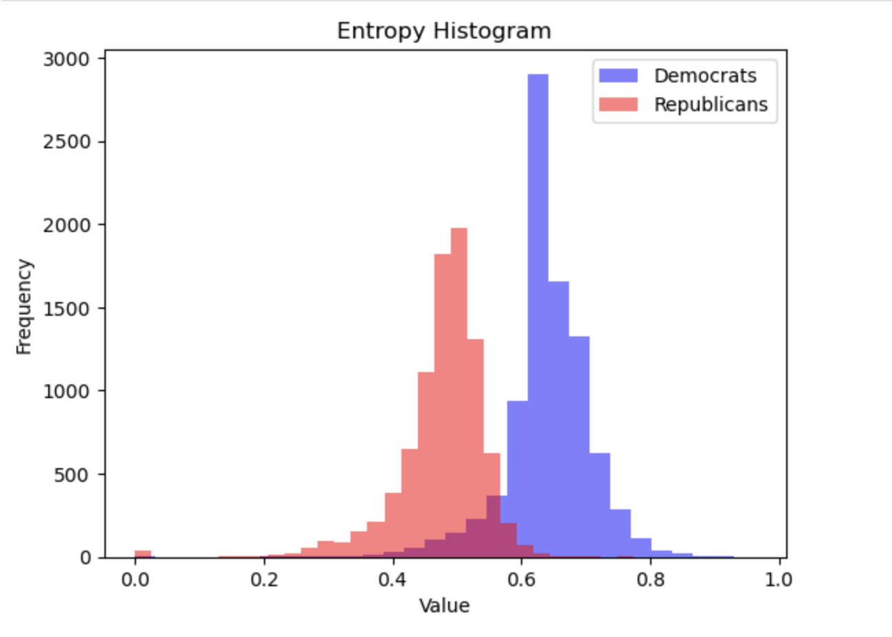
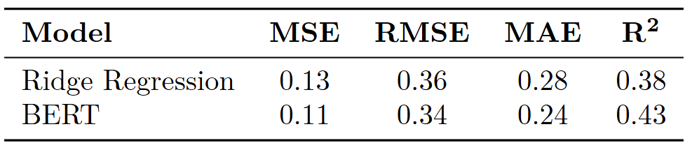
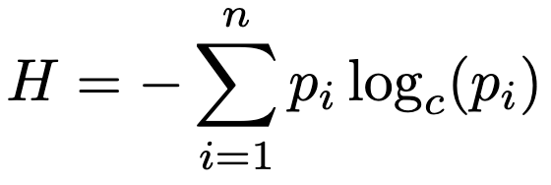
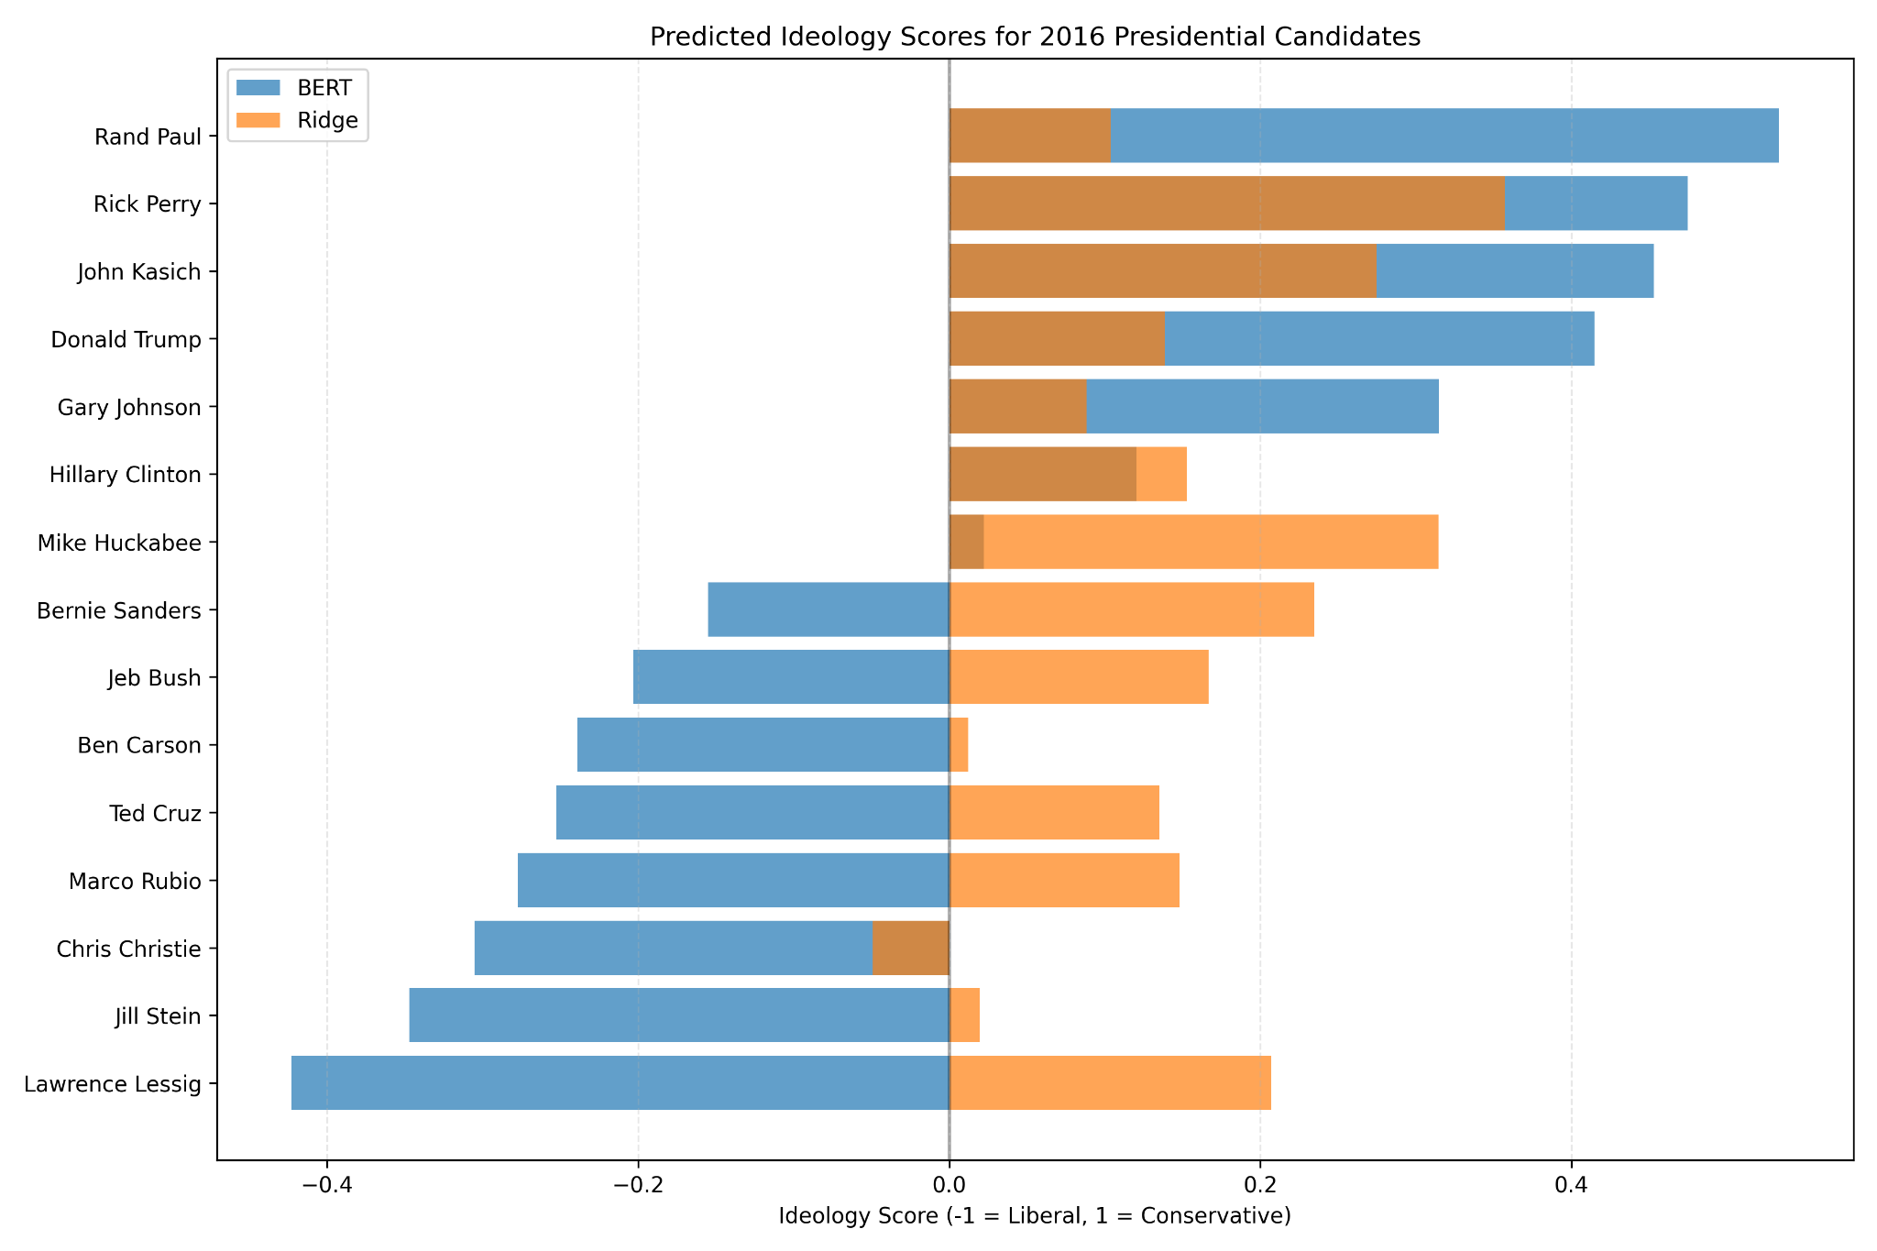
Why Do U.S. Banks Hold Excess Capital Beyond Regulatory Requirements
after the 2017 Basel III CET1 Requirements?
Suryansh Agrawal
Department of Data Analytics, Denison University
Department of Economics, Denison University
Motivation
Methodology
Results (Cont.)
Following the implementation of Basel III in 2017, U.S. banks have continued to hold equity capital well above regulatory minimums. This paper investigates the motivations behind this behavior, challenging the assumption that regulatory requirements alone drive capital levels. Drawing from Minsky’s Financial Instability Hypothesis and market discipline literature, the study explores whether excess capital reflects precautionary motives, profitability strategies, systemic risk perceptions.
Predicting Political Ideology
Our analysis of the 2016 Ohio primary election data reveals a fragmented voter base, posing challenges for Democrats in consolidating support. In contrast, lower entropy in Republican primaries indicates a more unified electorate, likely strengthening their general election performance.
We explored two modeling approaches:
Traditional Machine Learning – We applied Ridge Regression to predict ideology scores using extracted text features.
Transformer-Based Model – We fine-tuned a pre-trained BERT model on the scraped website content to learn ideological representations.
Using the following null and alternative hypotheses:
H0​: μ1​=μ2
HA​: μ1​≠μ2​
Metrics of Ridge Regression and BERT models
Entropy Analysis
To assess whether primary election entropy correlates with general election outcomes, we analyzed precinct-level data from Ohio. We calculated the entropy of both Democratic and Republican primary results for each precinct using the entropy formula:
We perform T-test on the collected data we obtain a P-value of 0.0 helping us reject the null hypothesis. indicates that the means are significantly different.
Future Directions
Theoretical Framework
Future work will refine the ideological classification model by fine-tuning it and testing transformer-based models for improved accuracy. It will also be integrated into a broader framework that forecasts election outcomes by combining linguistic analysis with factors like polling data, demographics, and campaign spending. This approach aims to better understand the relationship between political rhetoric and electoral success. Additionally, DW-NOMINATE can evolve over time due to shifts in voting behavior, such as partisan realignment and increasing polarization, which we can analyze to track how the political ideologies of the two parties change.
Minsky’s Financial Instability Hypothesis: Financial systems are inherently prone to instability. Excess capital may act as a cushion against boom-bust credit cycles.
Modigliani–Miller (1958): Theory vs. Practice: While capital structure is theoretically irrelevant under perfect markets, real-world frictions incentivize conservative capital behavior.
Market Discipline & Expectations: Investors reward prudence: banks may hold excess CET1 to signal strength and avoid market penalties.
To validate the test a two-sample t-test assesses whether differences in entropy between Democrat- and Republican-won precincts were statistically significant.
Results
References
Sapiro-Gheiler, Eitan. (2019). Examining Political Trustworthiness through Text-Based Measures of Ideology. Proceedings of the AAAI Conference on Artificial Intelligence.
2016 Official Elections Results. (2016). Ohiosos.gov. https://www.ohiosos.gov/elections/election-results-and-data/2016-official-elections-results/ ‌
Data
Data Source:
Bloomberg Terminal (February 2025)
BASEL III (January 2017)
Sample: 10 U.S. publicly traded banks (2016–2023)
Key Independent Variables:
Return on Assets (ROA)
Non-Performing Loan Growth (%)
Bank Size (log total assets)
Market Beta (volatility proxy)
Acknowledgements
Prof. Alexandre Scarcioffolo, Department of Data Analytics , Denison University.
Prof. Fadhel Kaboub, Department of Economics, Denison University.
Prof. Hyun Woong Park, Department of Economics, Denison University.
Departments of Data Analytics and Economics at Denison University.
BERT produces wider distribution across ideological spectrum

